Slide 1
Neural Net Report
Your Name: Nakul Kuttua
Your GT Username: nkuttua3

Slide 2
Question 5: Learning With Restarts
testPenData:
Max accuracy: 0.9116638078902229
Average accuracy: 0.9069182389937108
Standard deviation: 0.0028792860633537064
testCarData:
Max accuracy: 0.995
Average accuracy: 0.9890000000000001
Standard deviation: 0.0037416573867739447

Slide 3
Question 6: Varying the Hidden Layers
Statistic table for testPenData – report the max, average, and standard deviation at various amount of perceptrons.
 | Number of Perceptrons at the Hidden Layer
 | 0 | 5 | 10 | 15 | 20 | 25 | 30 | 35 | 40
Max Accuracy | 0 | 0.8461978273299028 | 0.9010863350485993 | 0.9065180102915952 | 0.9045168667810177 | 0.9093767867352773 | 0.906232132647227 | 0.9045168667810177 | 0.9056603773584906
Avg Accuracy | 0 | 0.8331046312178387 | 0.8331046312178387 | 0.8926815323041739 | 0.8986277873070326 | 0.898399085191538 | 0.9041166380789022 | 0.8986277873070326 | 0.8955403087478558
Standard Deviation | 0 | 0.01691120314364647 | 0.01691120314364647 | 0.006538041101851487 | 0.0074867201586917105 | 0.005488850771869649 | 0.0017304455060516543 | 0.005935249524236003 | 0.007815708671106609

Slide 4
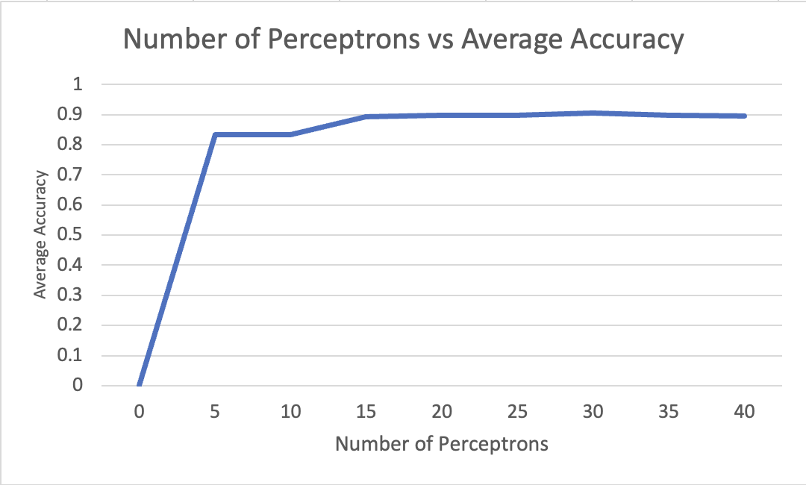
Question 6: Varying the Hidden Layers
Create a learning curve for testPenData where the number of hidden layer perceptrons is the independent variable and the average accuracy is the dependent variable.

Slide 5
Question 6: Varying the Hidden Layers
For testPenData, discuss any notable trends you saw related to increasing the size of the hidden layers in your neural net.
Answer: Some trends that I noticed were that there was a huge spike in average accuracy from 0 to 5 perceptrons but after that, there was very little improvement in average accuracy.

Slide 6
Question 6: Varying the Hidden Layers
Statistic table for testCarData – report the max, average, and standard deviation at various amount of perceptrons.
 | Number of Perceptrons at the Hidden Layer
 | 0 | 5 | 10 | 15 | 20 | 25 | 30 | 35 | 40
Max Accuracy | 0.72 | 0.995 | 0.995 | 0.99 | 0.995 | 0.99 | 0.995 | 0.99 | 0.985
Avg Accuracy | 0.72 | 0.984 | 0.9879999999999999 | 0.9869999999999999 | 0.9880000000000001 | 0.985 | 0.9880000000000001 | 0.9879999999999999 | 0.985
Standard Deviation | 0 | 0.01019803902718558 | 0.00509901951359279 | 0.0024494897427831805 | 0.00509901951359279 | 0.007745966692414842 | 0.0040000000000000036 | 0.00244948974278318 | 0

Slide 7
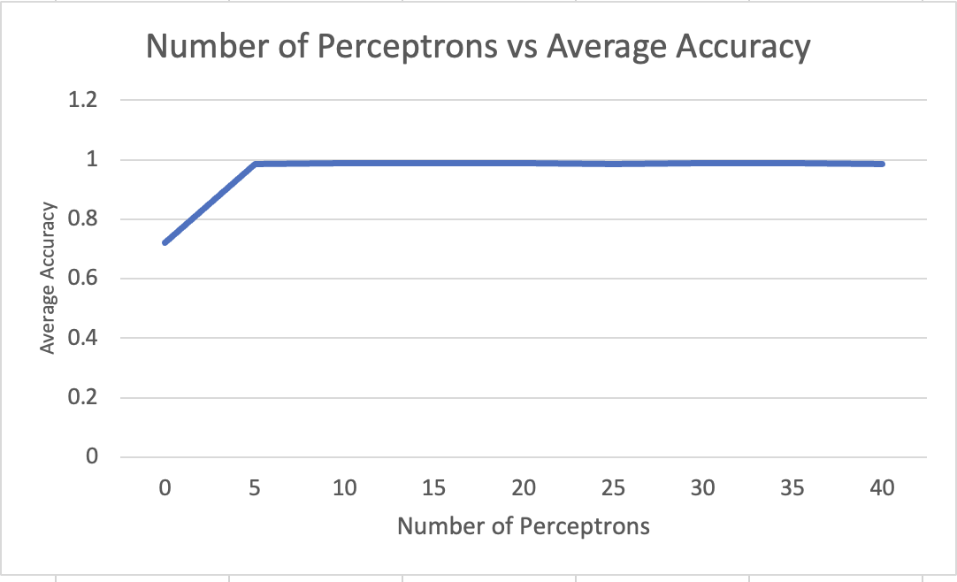
Question 6: Varying the Hidden Layers
Create a learning curve for testCarData where the number of hidden layer perceptrons is the independent variable and the average accuracy is the dependent variable.

Slide 8
Question 6: Varying the Hidden Layers
For testCarData, discuss any notable trends you saw related to increasing the size of the hidden layers in your neural net.
Answer: Some trends I noticed were that the biggest spike in average accuracy was from 0 to 5 perceptrons, but again there was very little noticeable change in average accuracy after that. At some points, the accuracy actually started to drop down a little bit.

Slide 9
Question 7 (extra credit): Learning XOR
Report the max accuracy, average accuracy, and standard deviation of the neural net that you have trained with 1) no hidden layer, and 2) a hidden layer with various amount of perceptrons (at least 3 different amounts)
 | No Hidden Layer | Hidden Layer
 |  | 5 perceptrons | 10 perceptrons | 20 perceptrons
Max Accuracy | 0.5 | 0.75 | 0.5 | 1
Avg Accuracy | 0.1 | 0.45 | 0.4 | 0.5
Standard Deviation | 0.2 | 0.29154759474226505 | 0.1224744871391589 | 0.27386127875258304

Slide 10
Question 7 (extra credit): Learning XOR
Report the behavior of the trained neural net without a hidden layer.
Answer: At 0 perceptrons, the average accuracy is 10%, the max accuracy is 50%, and the standard deviation is 0.2. These were all very clean numbers.

Slide 11
Question 7 (extra credit): Learning XOR
Report the behavior of the trained neural net with a hidden layer. Are the results what you expected? Explain your observation.
Answer: As the number of perceptrons increased, so too did the average accuracy. The accuracy does eventually reach 100%. But when the learning rate is increased, the number of perceptrons actually reduces.

Slide 12
Question 8 (extra credit): Novel Dataset
List the name and the source of the dataset that you’ve chosen.
Name: ______
Source (e.g., URLs): ______
Briefly describe the dataset: _____

Slide 13
Question 8 (extra credit): Run Stats
Max accuracy: _______
Average accuracy: _______
Standard deviation: ________

Slide 14
Question 8 (extra credit): Novel Dataset
Describe how to run the code that you’ve set up to train the selected dataset.
Answer:

